Slide 1
UNLOCKING IONIC
A pandora’s box of awesome, powerful components

Slide 2
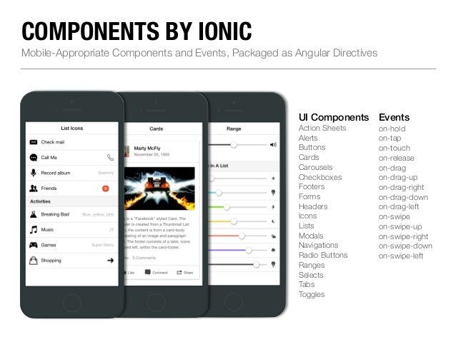
Whoa Li, Slow Down! What’s A Component?
“Ionic apps are made of high-level building blocks called components. Components allow you to quickly construct an interface for your app. Ionic comes with a number of components, including modals, popups, and cards. Check out the examples below to see what each component looks like and to learn how to use each one. ”
From Ionics Online Documentation

Slide 3
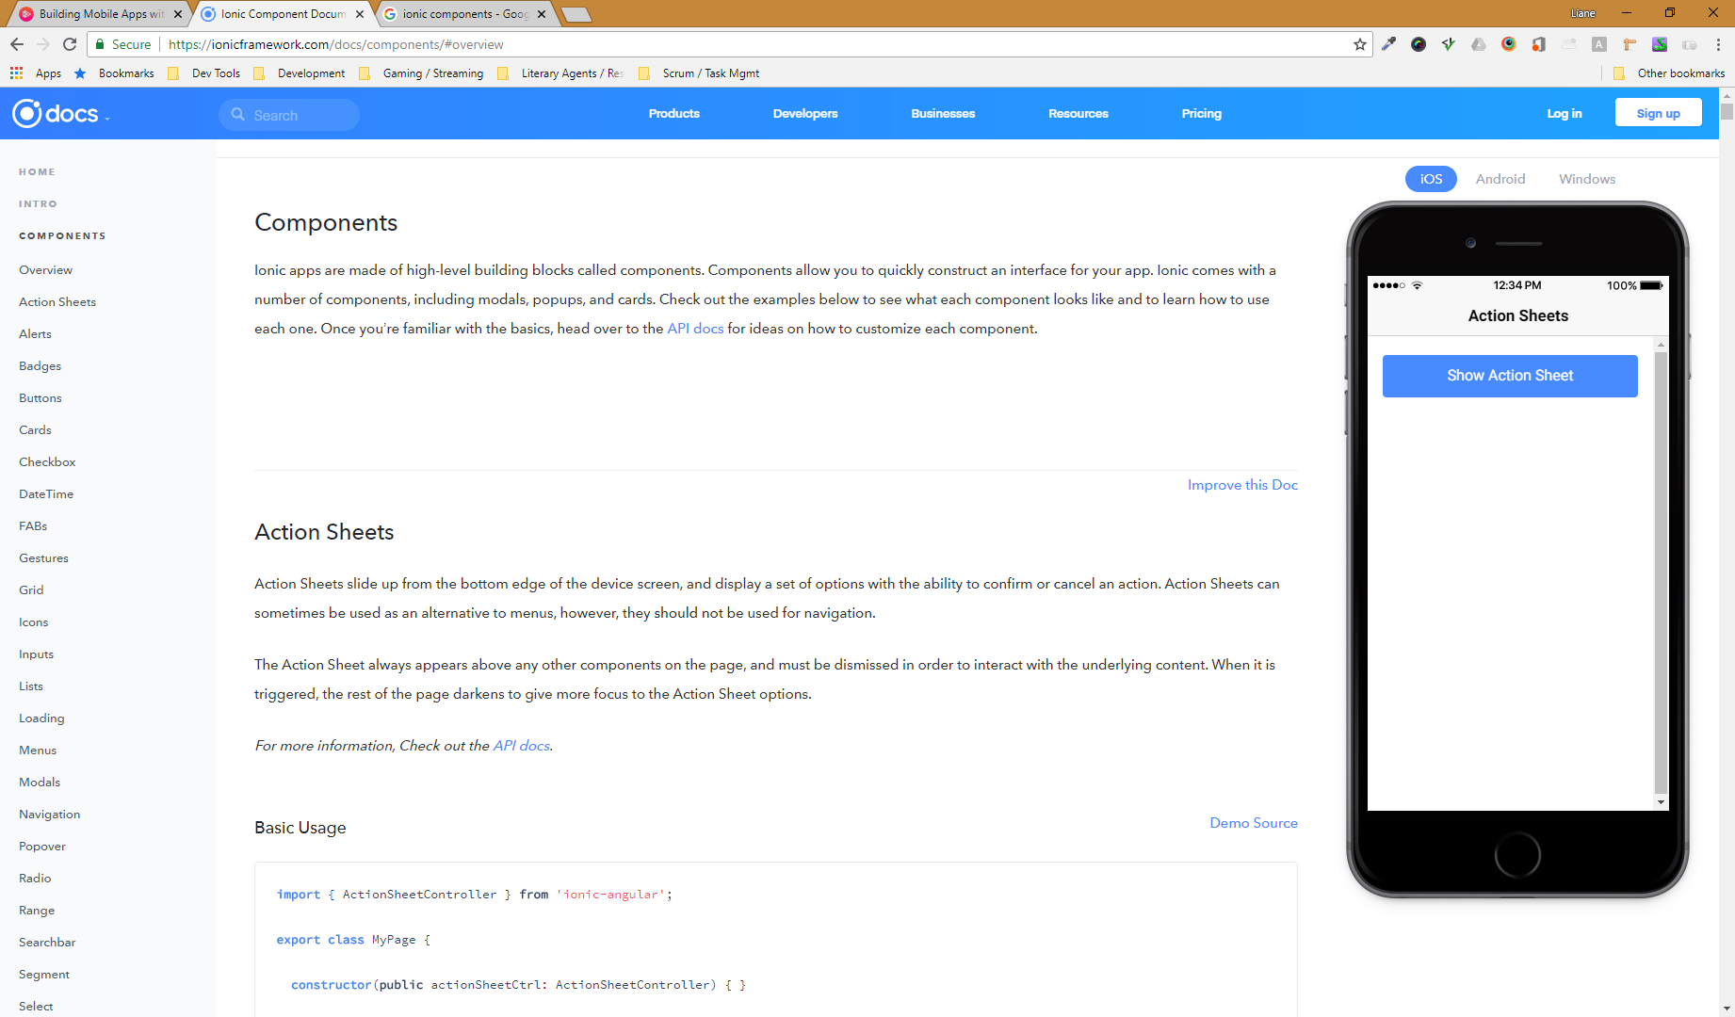

A Small Disclaimer…
There are 20+ components in Ionic
And more can added using plug-ins
We can’t cover them all in depth
We’ll cover as many as possible, but we’ll be covering them in a fly-by fashion
You can learn more about components in the Ionic Documentation
Take a look at the features you find interesting

Slide 4
CHALLENGE TIME!
Take a look at the Ionic Documentation and start to think about the tools you could use in your own mobile app.
Make a list of these components that would suit your mobile app.
Share the list with us on Discord!

